Slide 1
Breast Cancer Detection Using ML
group Members:
Abhinav KumAR
Archita DAS
Kumar Aman
Akshay agarwala
Anuj Kumar Gupta

Slide 2
What is machine learning?
“Learning is any process by which a system improves performance from experience”
“Machine Learning is concerned with computer programs that automatically improve their performance through experience”
- Herbert Simon (Turing Award 1975)

Slide 3
Breast Cancer: An Overview
Breast cancer is the second leading cause of cancer death in women, second only to lung cancer
The leading risk factor for breast cancer is simply being a woman. Though breast cancer does occur in men, the disease is 100 times more common in women.
Men can also get breast cancer. In 2017, the American Cancer Society estimates 2,470 new cases of invasive breast cancer will be diagnosed in men in the U.S.
A woman has about a one in eight chance of being diagnosed with breast cancer in her lifetime, according to the National Cancer Institute.
Most women (about eight out of 10) who get breast cancer do not have a family history of the disease.
But women who have close blood relative with breast cancer have a higher risk. Having a first-degree relative (mother, sister or daughter) with breast cancer almost doubles a woman's risk.

Slide 4
Why we are using machine learning?
Breast Cancer Biopsy Data
Machine Learning
Diagnosis

Slide 5
Flow Diagram
Biopsy Procedure
Measurements
Reports
Evaluation
Diagnosis
Analysis of Measurements
Preparation of ML Models
Predictions & Validation

Slide 6
Understanding the algorithm
The k-nearest neighbors (KNN) algorithm is a simple, supervised machine learning algorithm that can be used to solve both classification and regression problems. It’s easy to implement and understand, but has a major drawback of becoming significantly slows as the size of that data in use grows.
These algorithms are either quantitative or qualitative and are used to place a particular data set in a particular category or classification. The way that this algorithm works is through demarcation lines and decisions about boundaries. In this algorithm, K is the data point that the operator is trying to figure out more information about. The operator often wants to figure out what categories K fits in.

Slide 7

THE K-NEAREST NEIGHBORS (KNN) ALGORITHM
In order to do this, the algorithm draws a perimeter around K and studies the other data points within that perimeter. The data points within a determined perimeter help push the artificial intelligence machine to give K classification. Different neighbors in a different perimeter would lead to potentially different results for this algorithm. K-nearest neighbors is helpful for guiding machine learning and determining relationships while only knowing a limited amount of data about the situation.

Slide 8
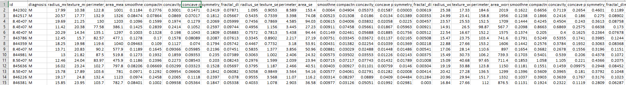
Let’s have a look at the Biopsy data

Slide 9
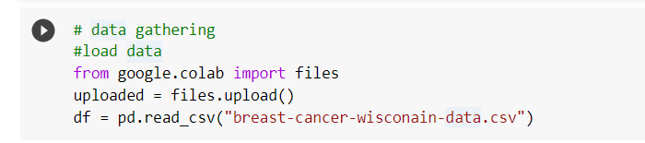
Step-1 → COLLECTING DATA
We will utilize the Wisconsin Breast Cancer Diagnostic dataset from the UCI Machine Learning Repository at http://archive.ics.uci.edu/ml. This data was donated by researchers of the University of Wisconsin. The breast cancer data includes 569 examples of cancer biopsies, each with 32 feature. From the Breast Cancer Dataset page, choose the Data Folder link. From there, grab breast-cancer-wisconsin-data.csv

Slide 10
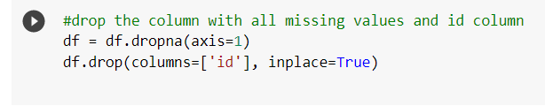
Step-2 → Cleaning the dataset
Before we can create the training and test data, we must remove the ‘id’ column. This column provides no value on the prediction on breast cancer. We also drop the column with all missing values.

Slide 11
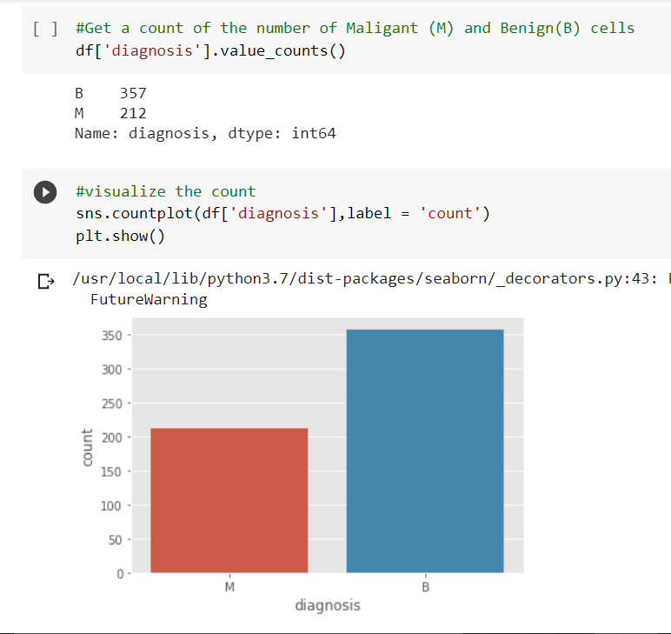
Step-3 → visualizing the data
The table( ) output indicates that 357 masses are benign while 212 are malignant

Slide 12
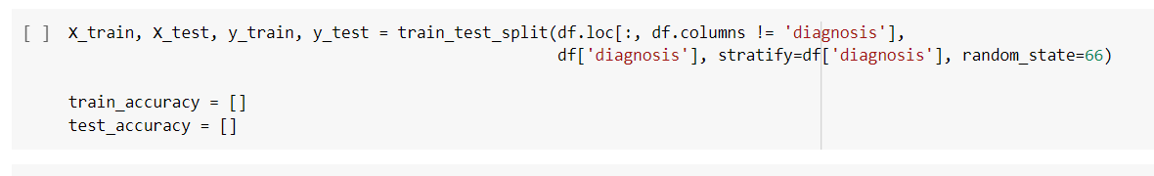
Step-4 → Training and Testing Data

